Slide 1

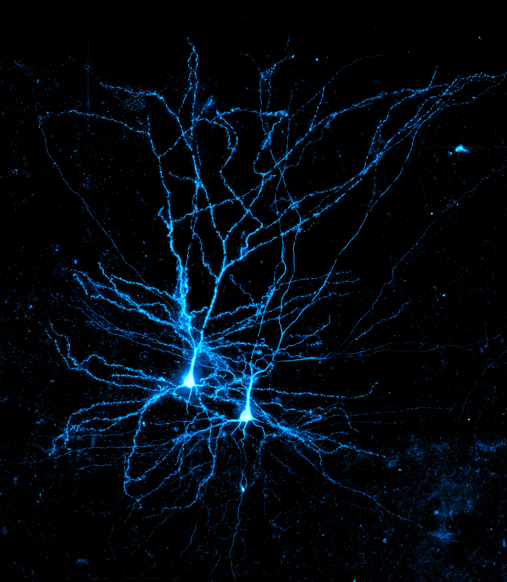
Chloride dynamics in the nervous system
Joseph Raimondo, University of Cape Town
Neuromatch, May 2020
Notes:
It is a real privilege to be giving a talk at neuromatch, especially as the only speaker currently based in the southern hemisphere.

Slide 2

University of Cape Town
Notes:
I’m from Cape Town, so like many of you I live and study far from the powerhouses of neuroscience in the global north, so initiatives like neuromatch, really help level the playing field and allow us all to be involved in humanities latest efforts to understand the brain.

Slide 3
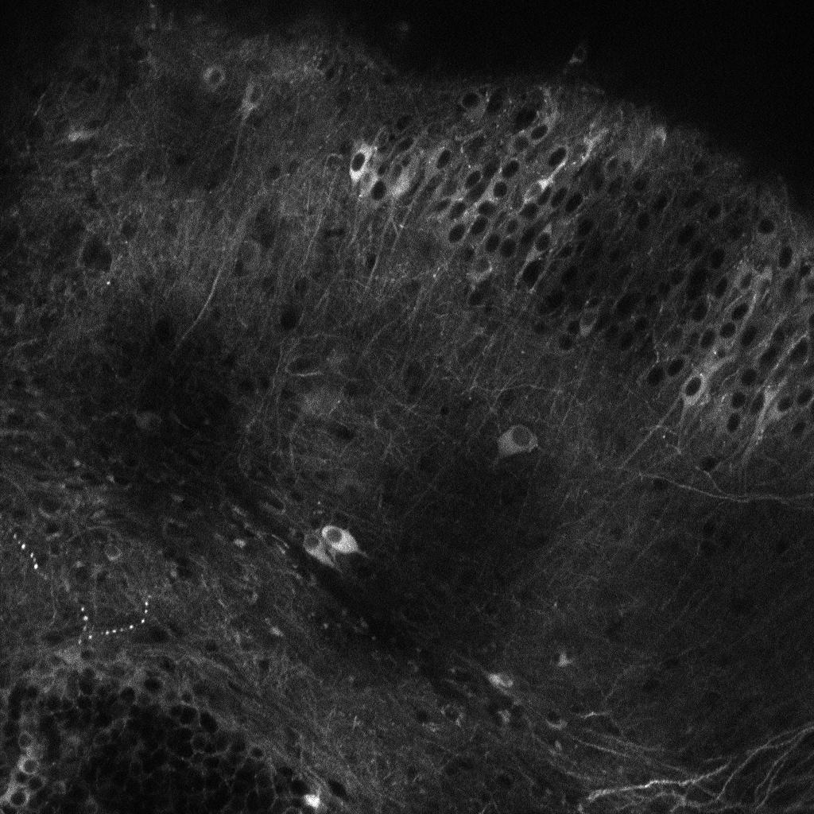

Slide 4
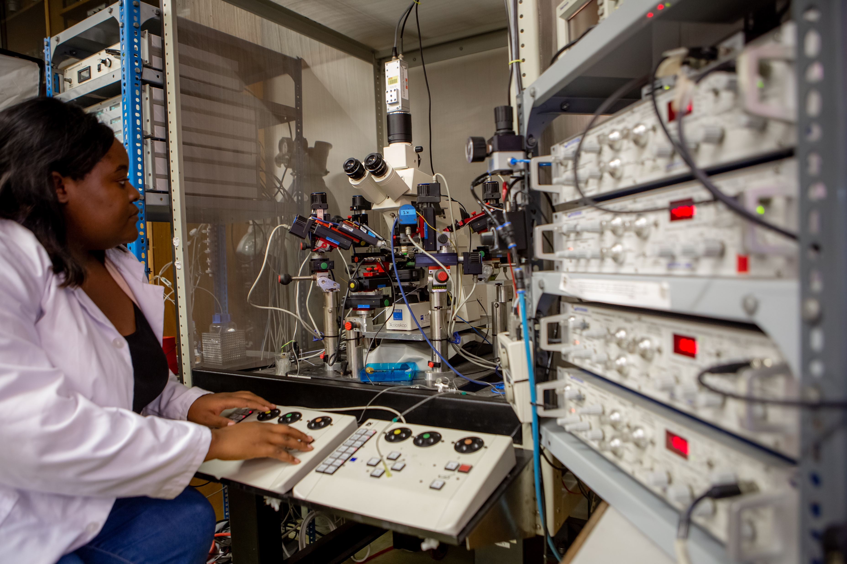
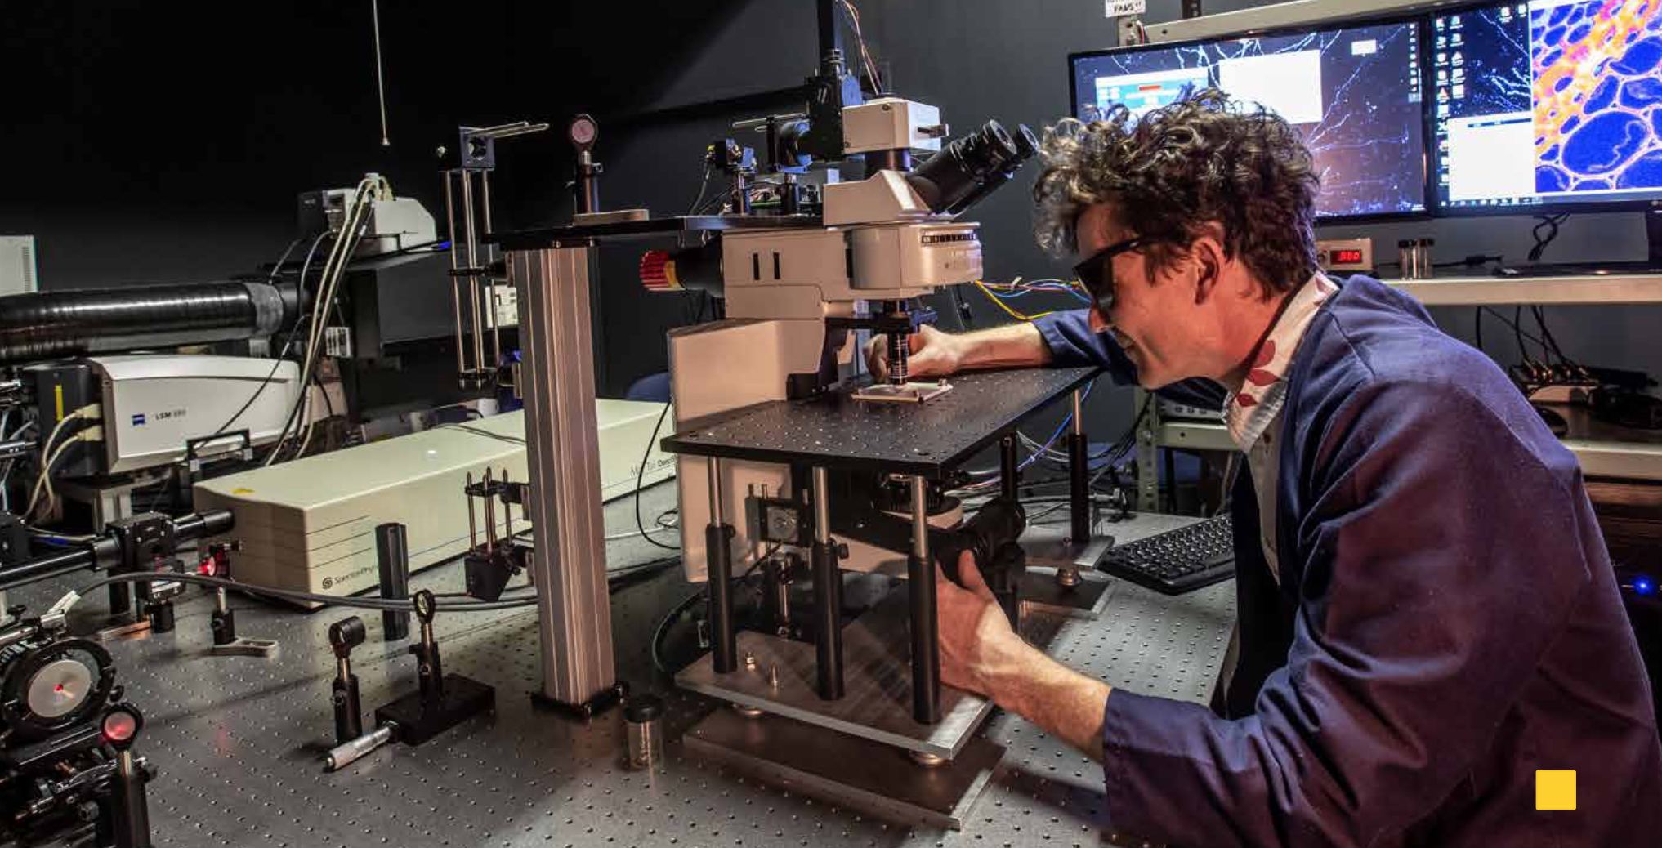
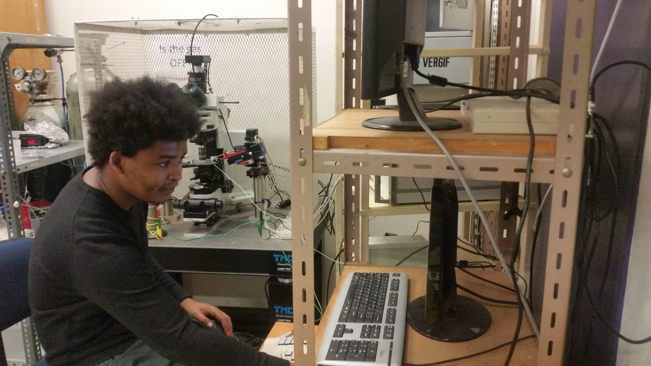
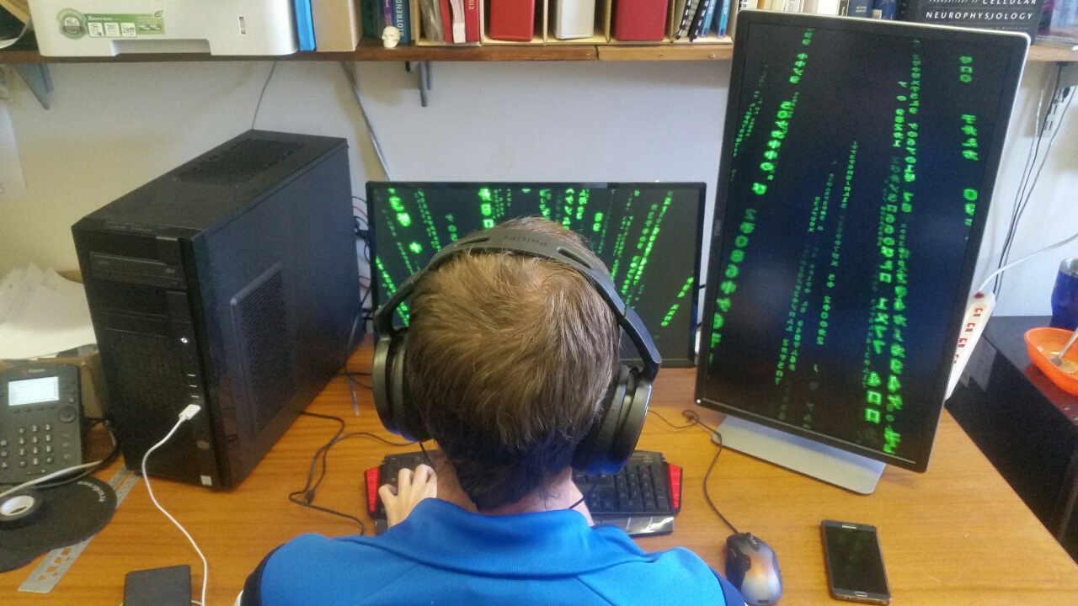
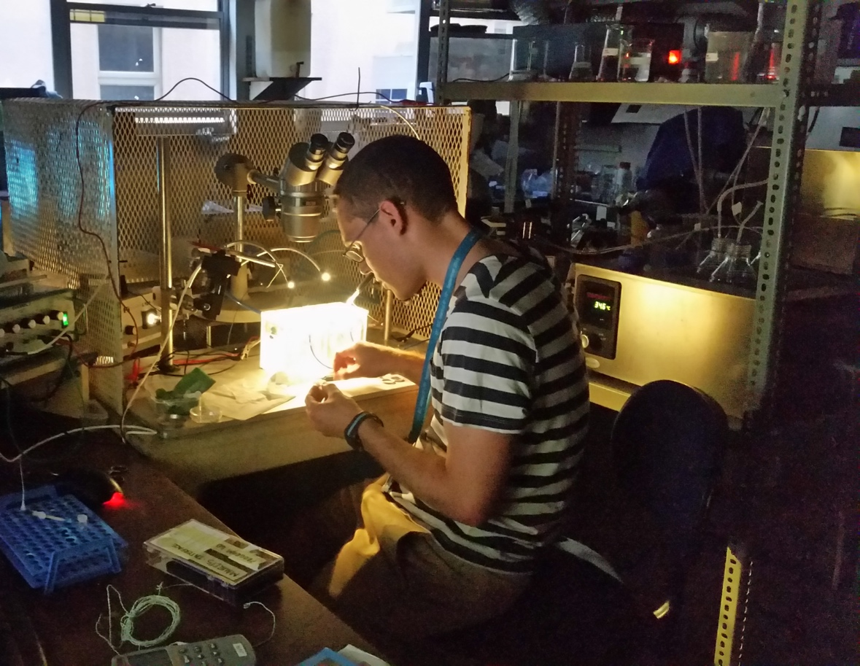
Why do brains seize?
Notes:
Intro to myself

Slide 5
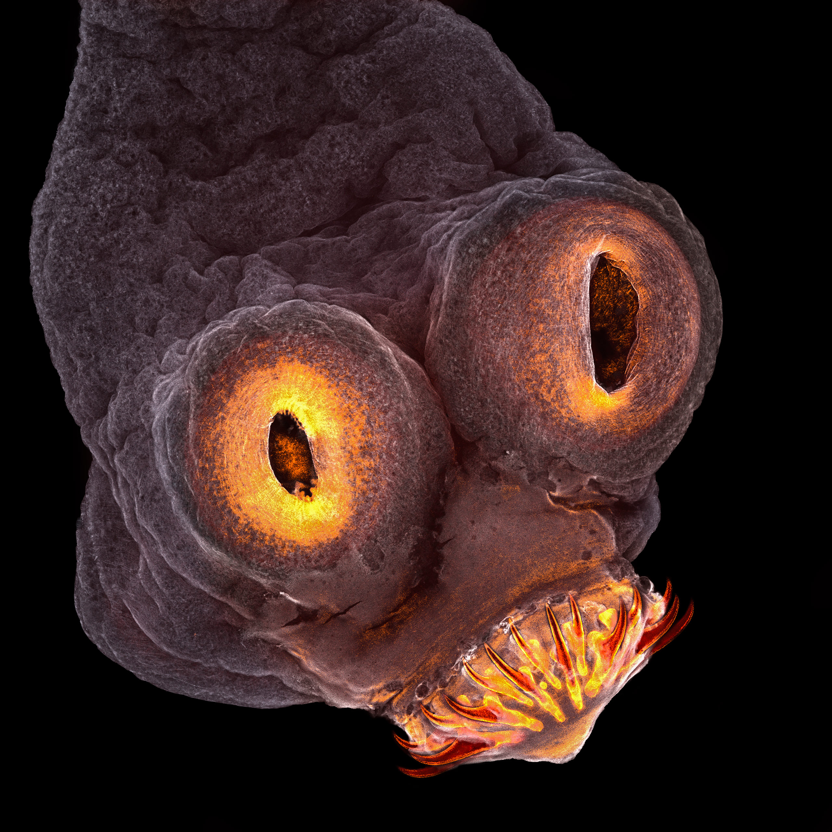
Tapeworm larvae in the brain are the most common cause of adult acquired epilepsy

Slide 6
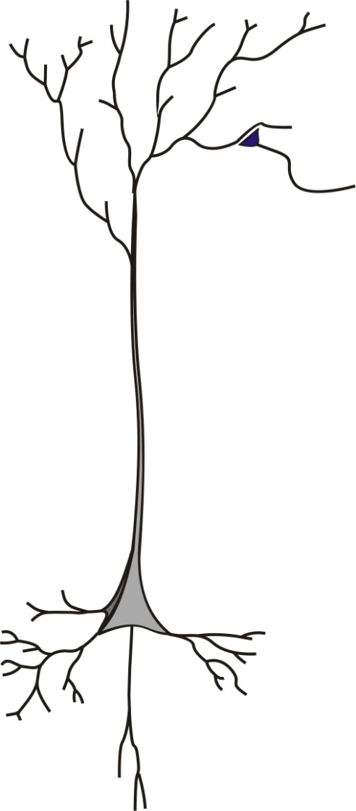
Talk outline
Inhibitory synaptic plasticity and chloride
Chloride dynamics modulate neuronal output
GABAergic signaling becomes excitatory during seizures
Relevance for the management of persistent seizures.

Slide 7
Talk outline
Inhibitory synaptic plasticity and chloride
Chloride dynamics modulate neuronal output
GABAergic signaling becomes excitatory during seizures
Relevance for the management of persistent seizures.

Slide 8
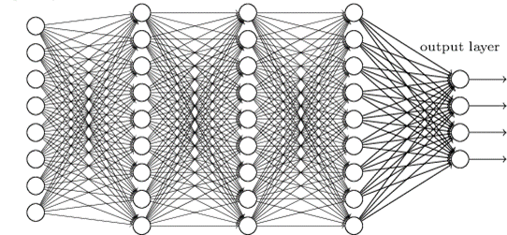
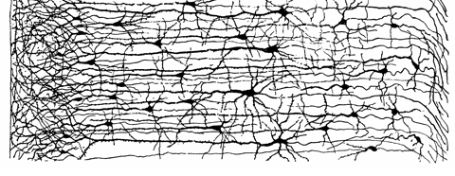
The ‘neuron’ is the basic building block of a network
artificial neural network
‘real’ neural network

Slide 9
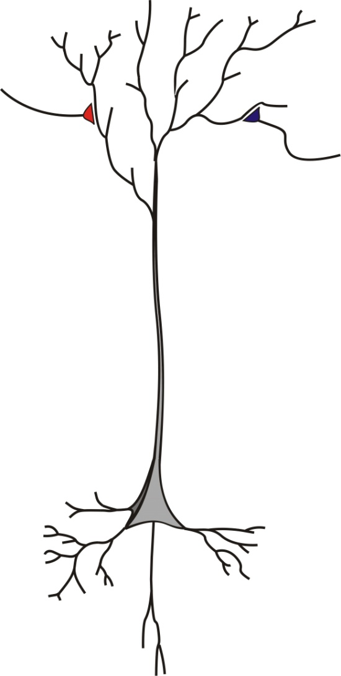
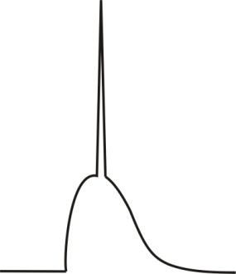
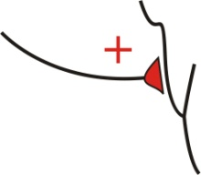
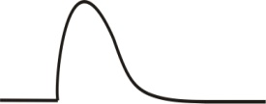

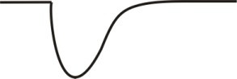
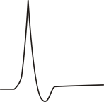
Neurons compute by integrating excitatory and inhibitory synaptic input.
+
=
-70 mV
+
=
-70 mV

Slide 10

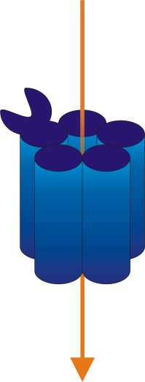

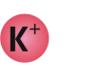




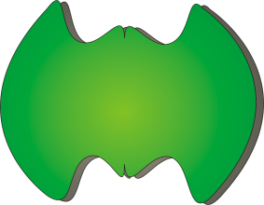
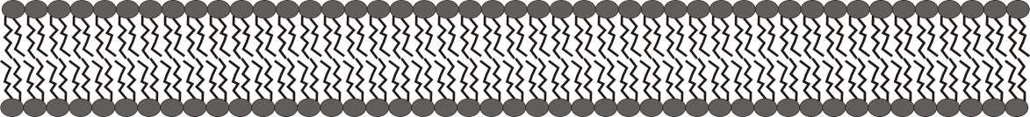


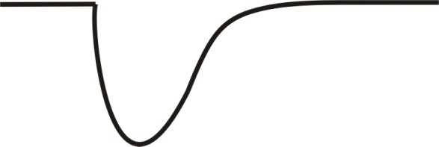
Fast synaptic inhibition depends on intracellular Cl⁻
GABA
-70 mV
-
-
-
-
-
-
GABA_{A}R
KCC2
Diffusion
-70 mV
Düsterwald et al. (2018) eLife
Notes:
Why are inhibitory inputs hyperpolarizing? When the primary inhibitory neurotransmitter GABA binds to its major recepter GABAA, Cl- ions typically travel down their concentration gradient into the cell. This makes the inside of the membrane more negative, hyperpolarizing the cell. Chloride is then cleared and the concentration gradient maintained by diffusion and the chloride transporter protein KCC2.

Slide 11
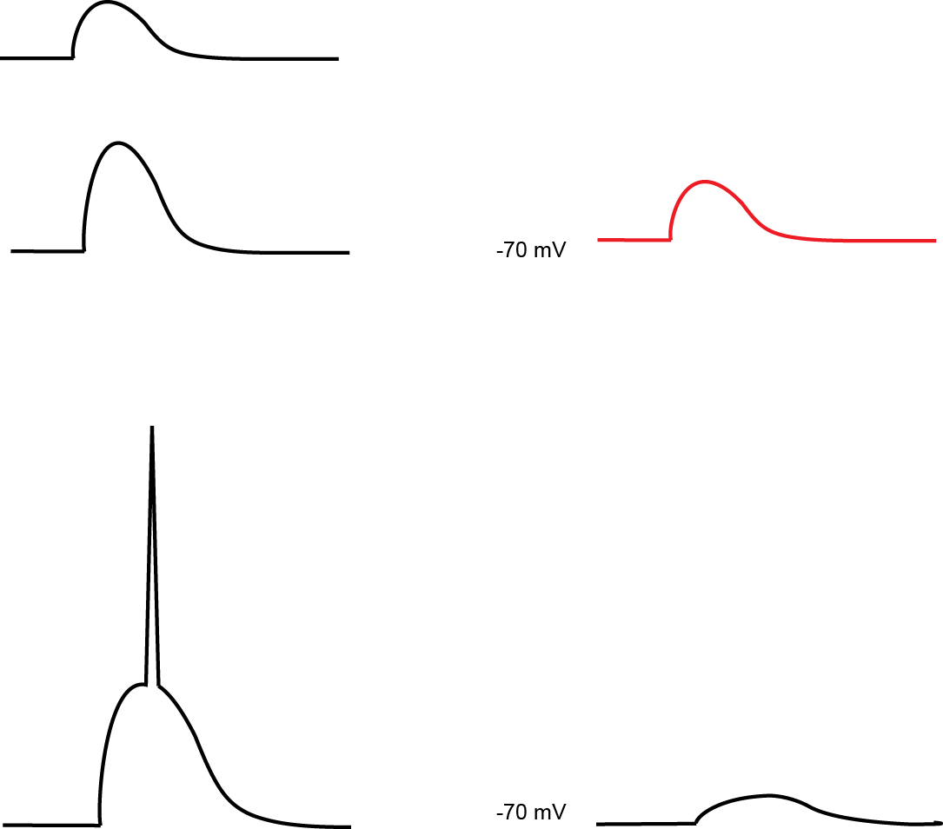
Modulating GABAergic transmission: plasticity
1. Changing presynaptic GABA release
GABA
2. Change number of GABA_{A} receptors
-70 mV

Slide 12
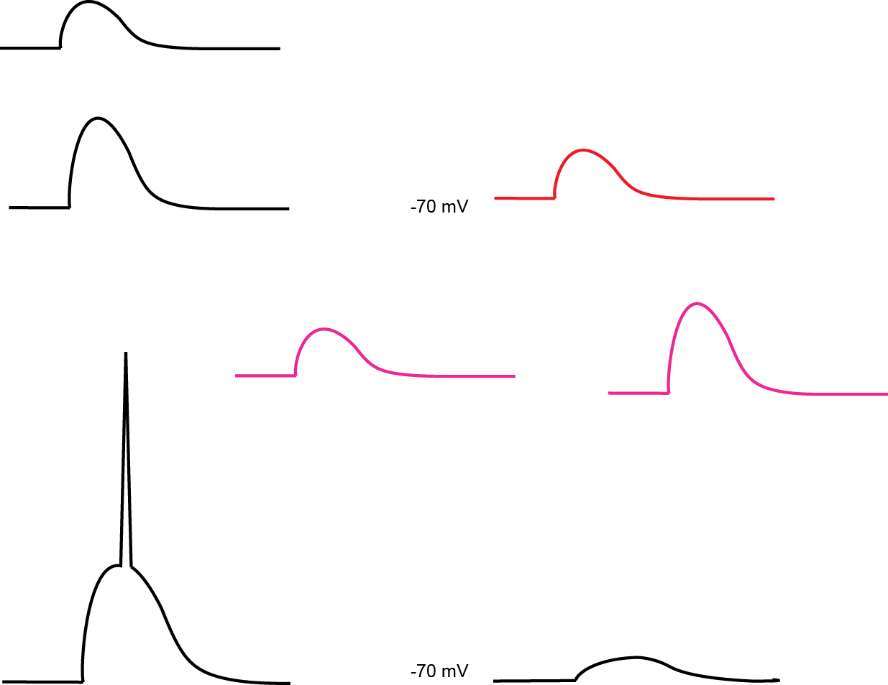
Modulating GABAergic transmission
Modulate GABA_{A}R function
GABA
Alcohol/ Benzodiazepines
-70 mV

Slide 13
An alternative form of GABAergic plasticity that depends on changes to intracellular Cl⁻
GABA

Slide 14
An alternative form of GABAergic plasticity that depends on changes to intracellular Cl⁻
GABA

Slide 15
An alternative form of GABAergic plasticity that depends on changes to intracellular Cl⁻
GABA
-
-
-
-
-
-
-70 mV
E_{GABAA} = -85 mV

Slide 16
An alternative form of GABAergic plasticity that depends on changes to intracellular Cl⁻
GABA
-70 mV
E_{GABAA} = -85 mV

Slide 17
An alternative form of GABAergic plasticity that depends on changes to intracellular Cl⁻
GABA
-
-
-70 mV
E_{GABAA} = -75 mV

Slide 18
An alternative form of GABAergic plasticity that depends on changes to intracellular Cl⁻
GABA
-70 mV
E_{GABAA} = -75 mV

Slide 19
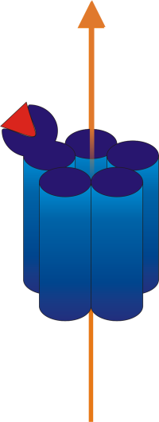

An alternative form of GABAergic plasticity that depends on changes to intracellular Cl⁻
GABA
+
+
+
+
E_{GABAA} = -65 mV
-70 mV

Slide 20
Talk outline
Inhibitory synaptic plasticity and chloride
Chloride dynamics modulate neuronal output
GABAergic signaling becomes excitatory during seizures
Relevance for the management of persistent seizures.

Slide 21
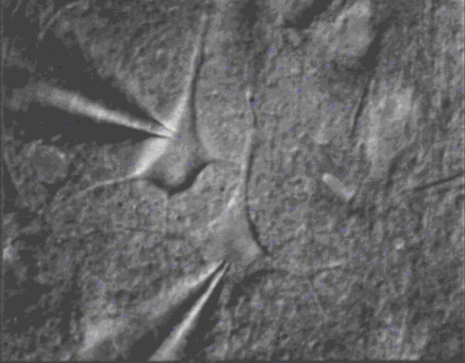
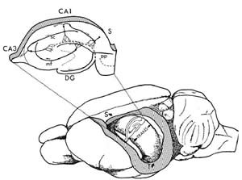

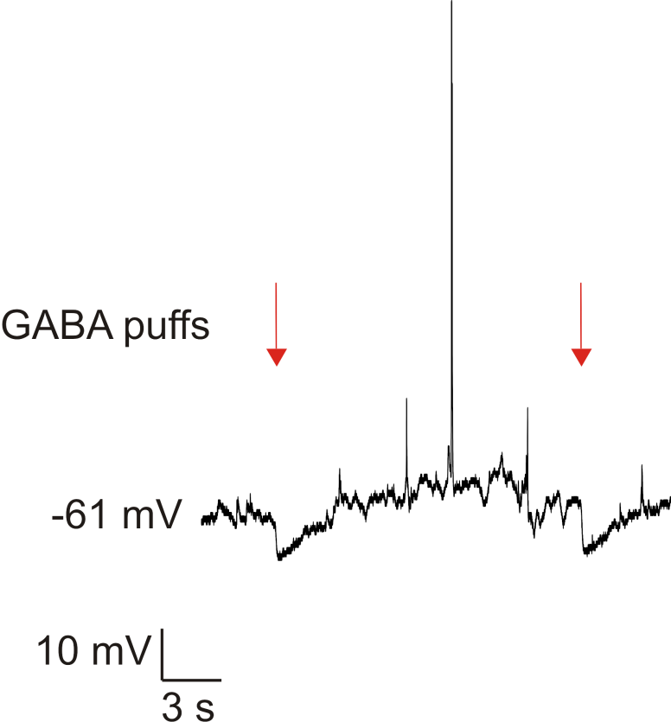
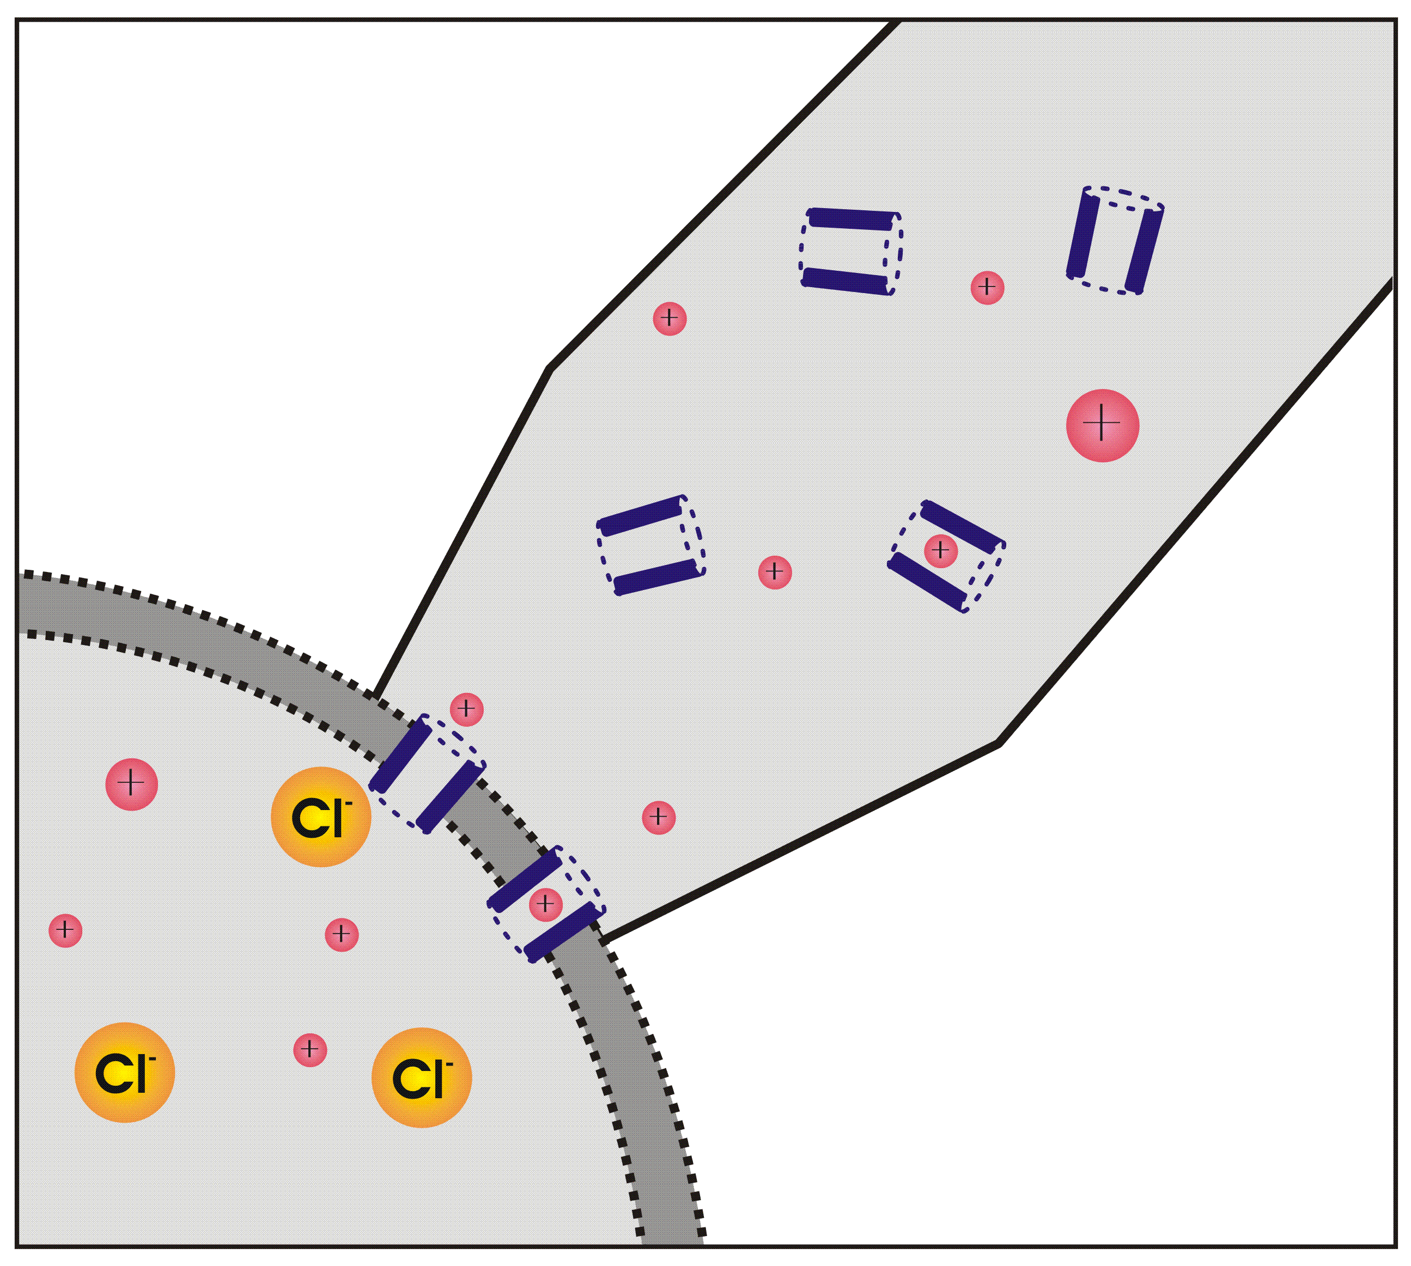
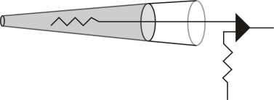
Assessing GABAergic transmission utilising gramicidin perforated patch-clamp technology
GABA
puffer
P14 – P21 Rats
Patch electrode
Gramicidin
Notes:
Redo gramicidin diagram and speed up slide
Make patch lines a bit thicker – change patch colour to green

Slide 22
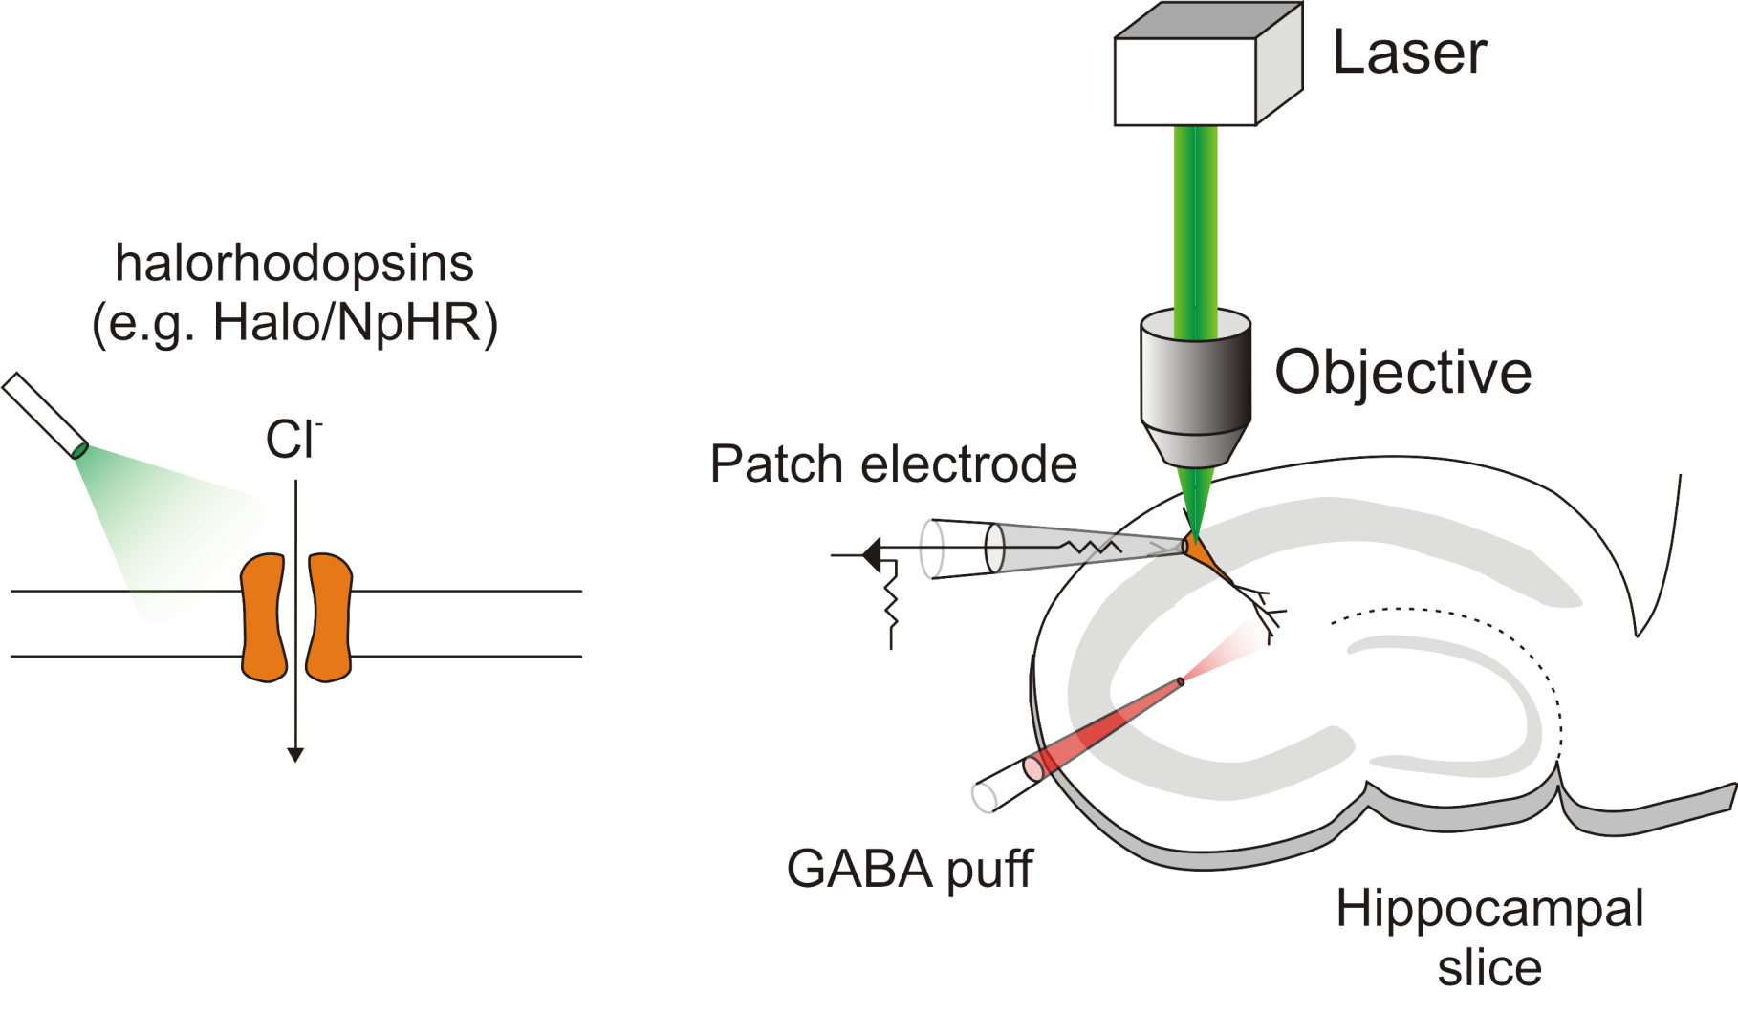
Intracellular Cl⁻ accumulation using a genetically encoded light-activated Cl⁻ pump
Raimondo et al. (2012) Nature neuroscience
Notes:
Microbial opsins

Slide 23
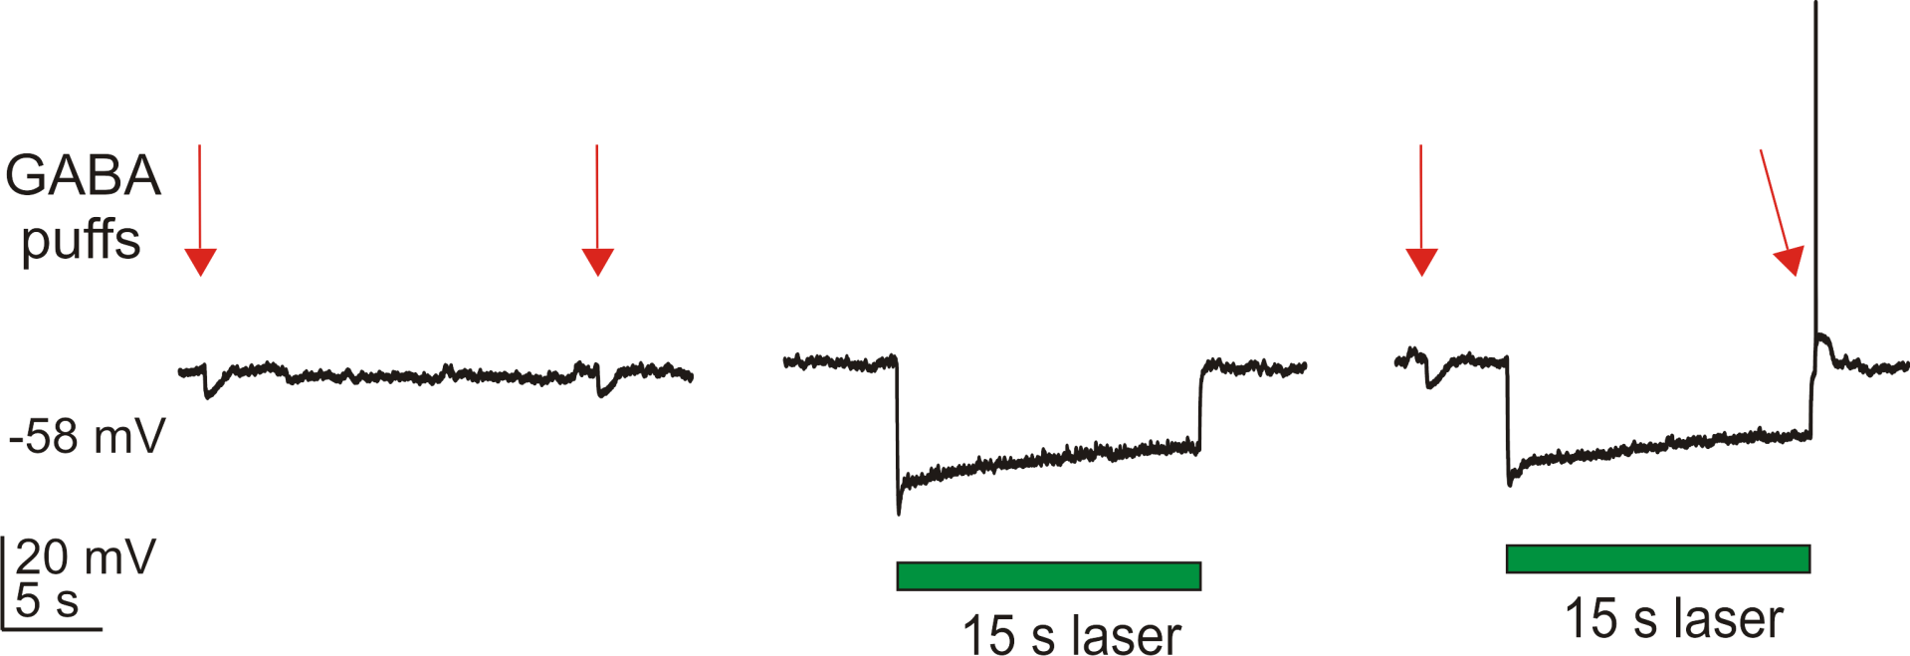
Cl⁻ accumulation renders GABAergic transmission depolarising
Raimondo et al. (2012) Nature neuroscience

Slide 24
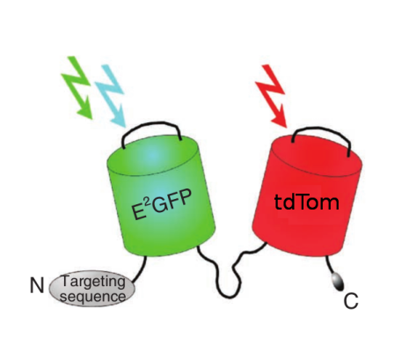
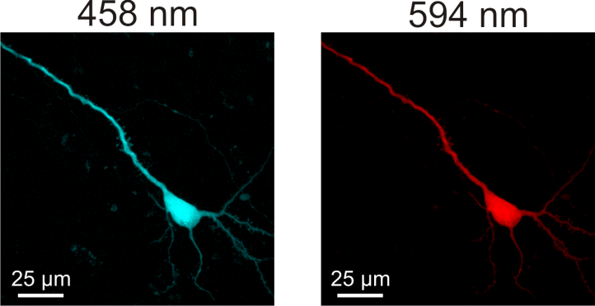
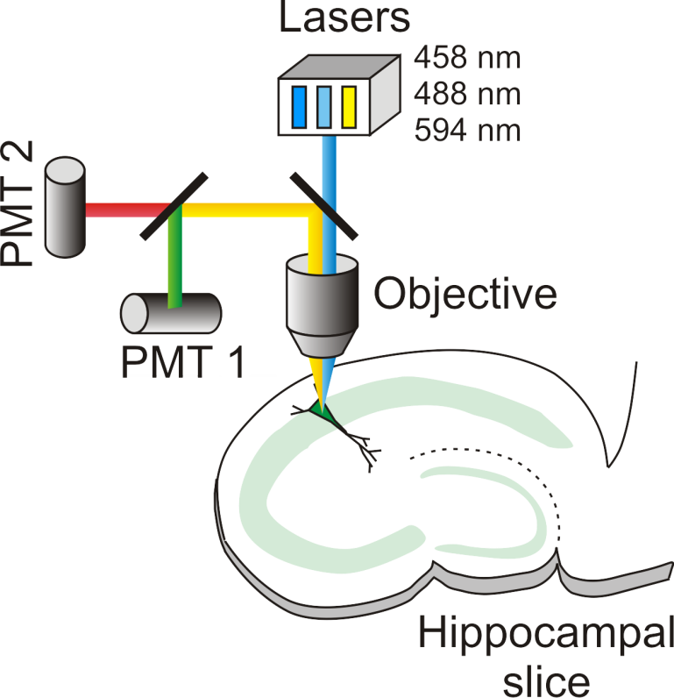
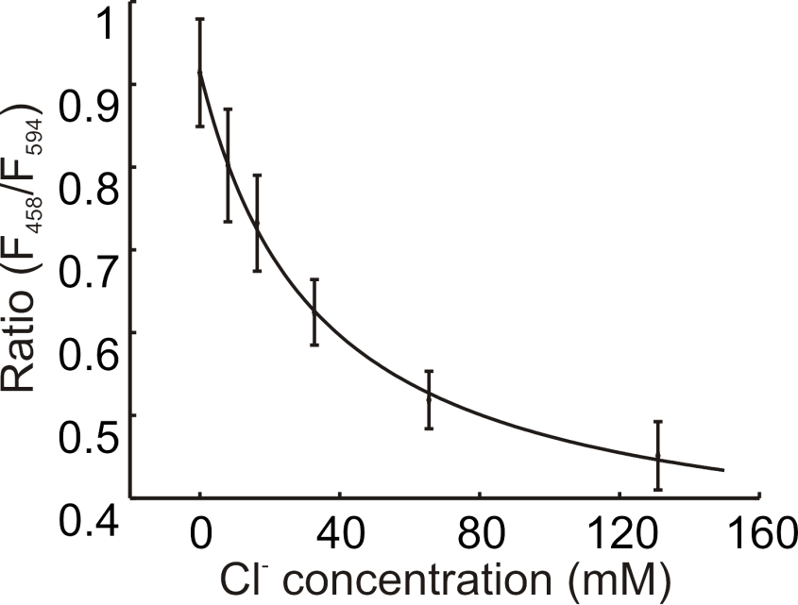
Imaging intracellular Cl⁻ concentration using a novel genetically encoded Cl⁻ sensor: ClopHensorN
ClophensorN
Raimondo et al. (2013) Front. Cell. Neurosci.

Slide 25
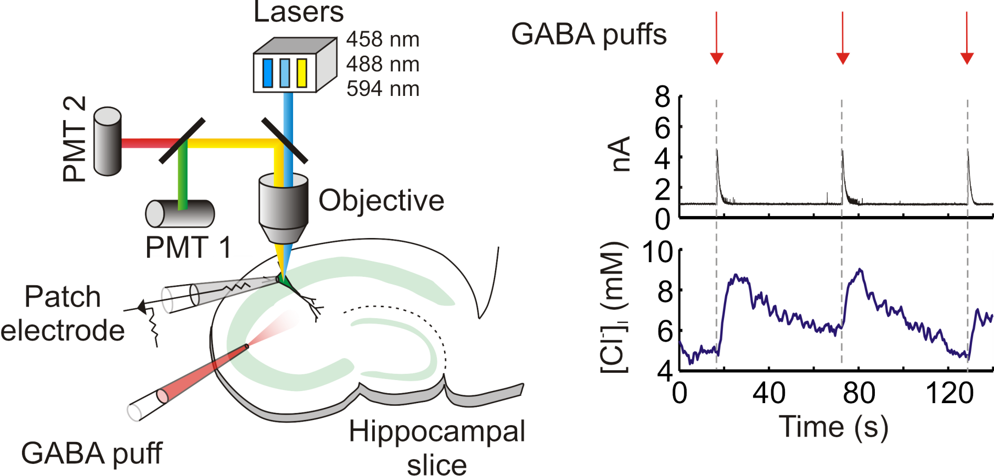
GABA_{A}R activation transiently increases intracellular Cl⁻
Raimondo et al. (2013) Front. Cell. Neurosci.

Slide 26
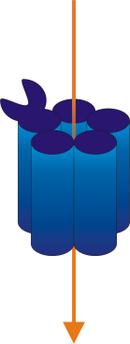
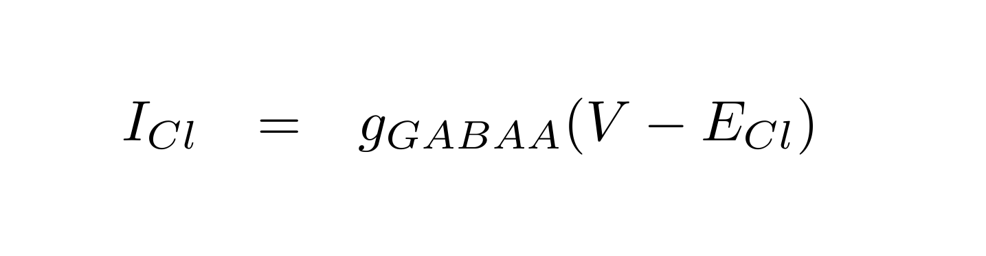
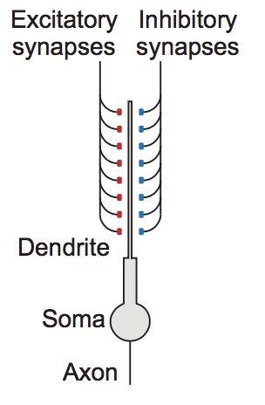
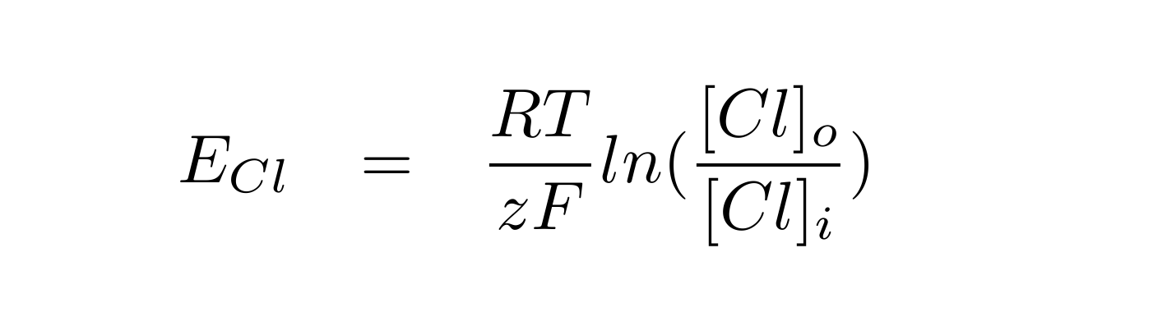


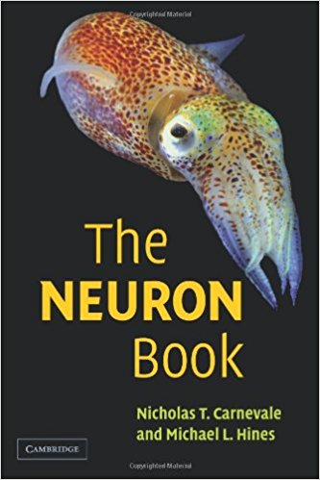

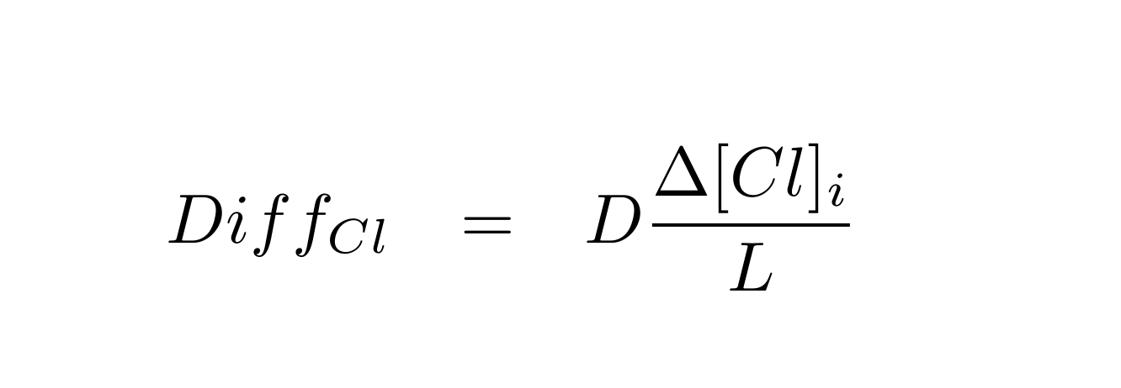



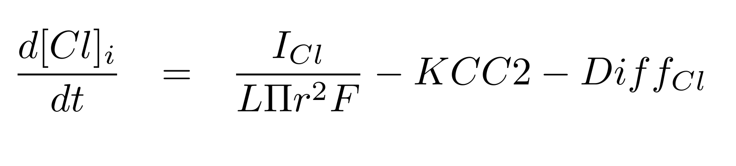
Chloride dynamics alter the input-output properties of neurons
Cl⁻ flux via GABA_{A}R
KCC2 pump
$$I_{KCC2}=P \left({\left[K^{+}\right]}_{i}{\left[{Cl}^{−}\right]}_{i}−{\left[K^{+}\right]}_{o}{\left[{Cl}^{−}\right]}_{o}\right)$$
Diffusion and Volume
Updated [Cl⁻]_{i}
Christopher Currin
Currin et al. (2020) PloS Comp. Bio. In press

Slide 27
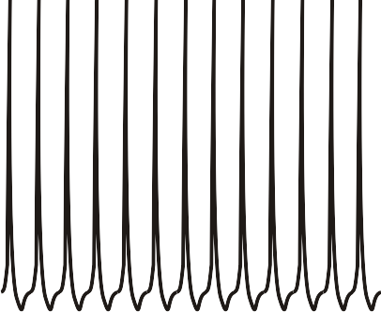
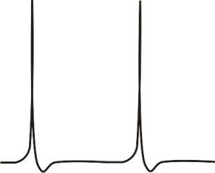
The neuronal input-output function.
Peripherally targeted inhibition offsets the neuronal IO function
Currin et al. (2020) PloS Comp Bio. In press

Slide 28
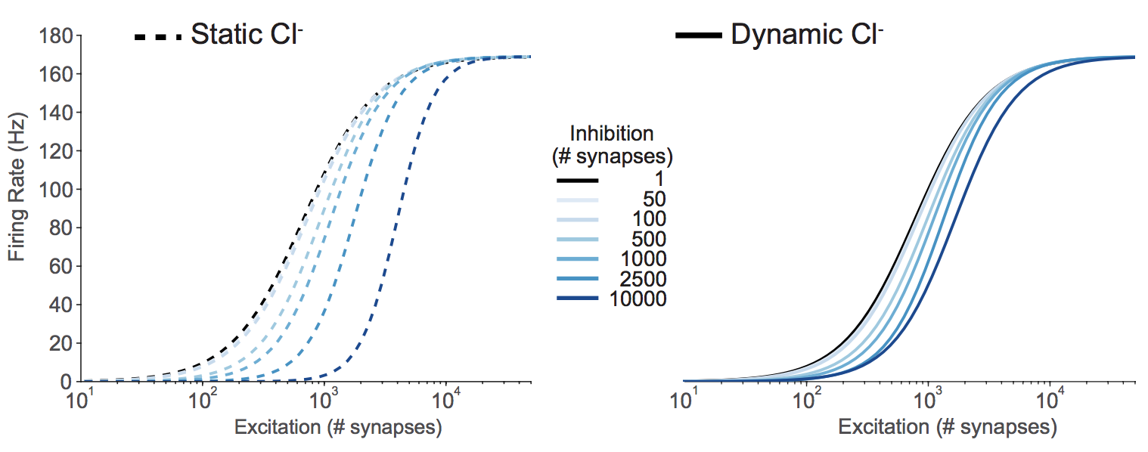
Dynamic Cl⁻ reduces the effectiveness of peripherally targeted inhibition for controlling output firing rates
Peripheral inhibition
Currin et al. (2020) PloS Comp Bio. In press

Slide 29
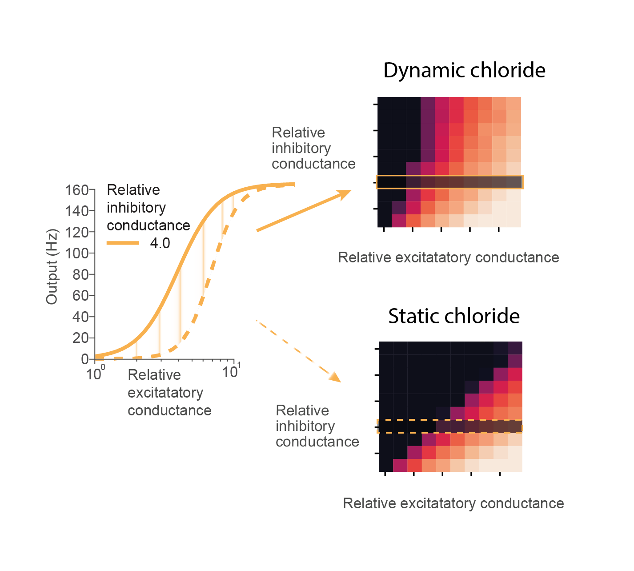
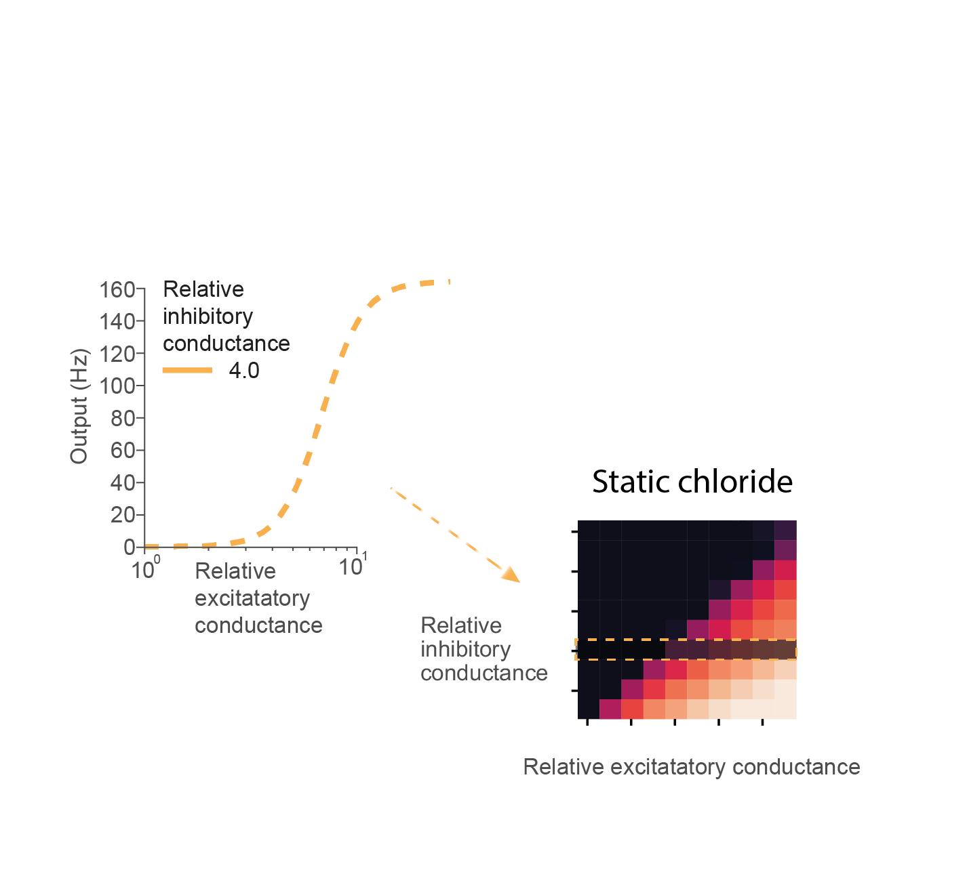
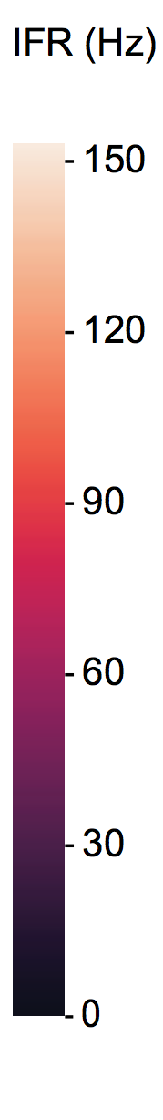
Chloride dynamically alters the input-output function
Currin et al. (2020) PloS Comp Bio. In press

Slide 30



Chloride dynamically alters the input-output function
Currin et al. (2020) PloS Comp Bio. In press

Slide 31


Chloride dynamically alters the input-output function
Currin et al. (2020) PloS Comp Bio. In press

Slide 32
Talk outline
Inhibitory synaptic plasticity and chloride
Chloride dynamics modulate neuronal output
GABAergic signaling becomes excitatory during seizures
Relevance for the management of persistent seizures.

Slide 33





During normal activity states excitation and inhibition are dynamically matched
+
+
+
+
+
+
-
-
-
-
-
+
-
+
+
+
+
+
-
-
-
-
-
-
+
+
+
excitation
+
-
inhibition
Normal activity
Notes:
Epileptic seizures reflect an imbalance between excitation and inhibition within neuronal networks
During normal activity excitatory and inhibitory inputs to neurons are well balanced
The network is stable
The output of neurons is not hypersynchronous and they are not firing wildly
In fact the activity patterns within the network will code for memories/ decisions/ movement

Slide 34
Epileptic seizures reflect a loss of matching between excitation and inhibition
+
+
+
+
+
+
-
-
-
-
-
+
-
+
+
+
+
+
-
-
-
-
-
-
+
+
+
excitation
+
-
inhibition
Epileptic activity
Notes:
During an epileptic seizure however, due to a variety of possible causes, excitation and inhibition become unbalanced
The output of neurons become hypersynchronous, and they begin firing wildly
The key to understanding epilepsy is understanding the circuit and cellular reasons for why this excitatory inhibitory balance is lost
essentially why networks become unstable
I’ve focused on the fast synaptic inhibition which is predominantly mediated by GABAaRs

Slide 35





Cl⁻ accumulates during single seizures
Raimondo et al. (2013) Front. Cell. Neurosci.

Slide 36




GABAergic transmission becomes excitatory during single epileptic seizures
0 Mg2+
GABA
puffer

Slide 37


GABAergic transmission becomes excitatory during single epileptic seizures
0 Mg2+
GABA
puffer
Ilie, Raimondo, Akerman (2012) Journal of neuroscience
Ellender*, Raimondo* et al. (2014) Journal of neuroscience

Slide 38
Cl⁻ accumulation during seizures causes a failure of recurrent inhibition
Excitation
Inhibition

Slide 39
Talk outline
Inhibitory synaptic plasticity and chloride
Chloride dynamics modulate neuronal output
GABAergic signaling becomes excitatory during seizures
Relevance for the management of persistent seizures.

Slide 40
Status epilepticus (SE)
Essentially a seizure that isn’t self terminating
Roughly 20% mortality
First line treatment includes positive allosteric modulators of GABA_{A}R: benzodiazepines (Diazepam/ Lorazepam) – often ineffective
Sometimes diazepam stops convulsions but not the seizure?

Slide 41



Benzodiazepine resistant SE in a South African cohort
Benzodiazepine resistant
Benzodiazepine sensitive
Richard Burman
Burman et al. (2019) Brain

Slide 42
The 0 Mg²⁺ in vitro model of seizures and status epilepticus
‘Seizures’
‘Status epilepticus’
Burman et al. (2019) Brain

Slide 43


Diazepam is antiseizure when applied early in a model of SE
+Diazepam
Burman et al. (2019) Brain

Slide 44



Diazepam is ineffective/ proseizure when applied late in a model of SE
Burman et al. (2019) Brain

Slide 45
Short-term activity dependent Cl- accumulation during SE-like activity
Gramicidin patch
0 Mg2+ Washout
SLEs
LRD
Burman et al. (2019) Brain

Slide 46


Chloride imaging using ClopHensorN confirms elevated intraneuronal chloride during SE-like activity
SLEs
LRD
Alexandru Calin
Burman et al. (2019) Brain

Slide 47
GABAergic interneurons drive epileptiform discharges during SE-like activity
Burman et al. (2019) Brain

Slide 48

Why do benzodiazepines sometimes work in Status Epilepticus?
Benzo effective
Benzo ineffective
Could make things worse
Perhaps we should be using a different 1st line agent for treating status epilepticus:
e.g. Phenobarbital (Dual action: enhances GABA_{A}Rs and antagonizes Glut receptors)

Slide 49
Summary
Fast inhibitory synaptic transmission depends in the transmembrane gradient for chloride
Chloride dynamics modulate neuronal output
GABAergic signaling becomes excitatory during seizures which is important for how we should manage status epilepticus

Slide 50






Funders:
Collaborators:
Andy Trevelyan, Colin Akerman, Neela Codadu, Alexandru Calin Ryley Parrish

Slide 51


Slide 52

Computational Neuroscience Imbizo: http://imbizo.africa – Jan 2022

